Slide 1
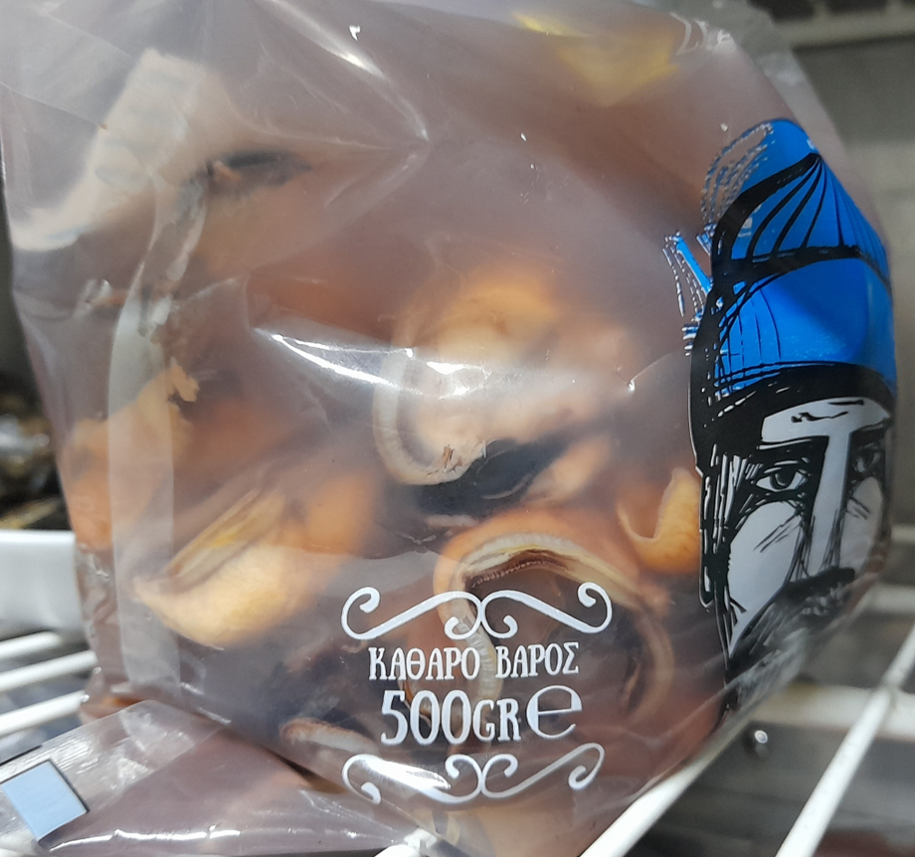
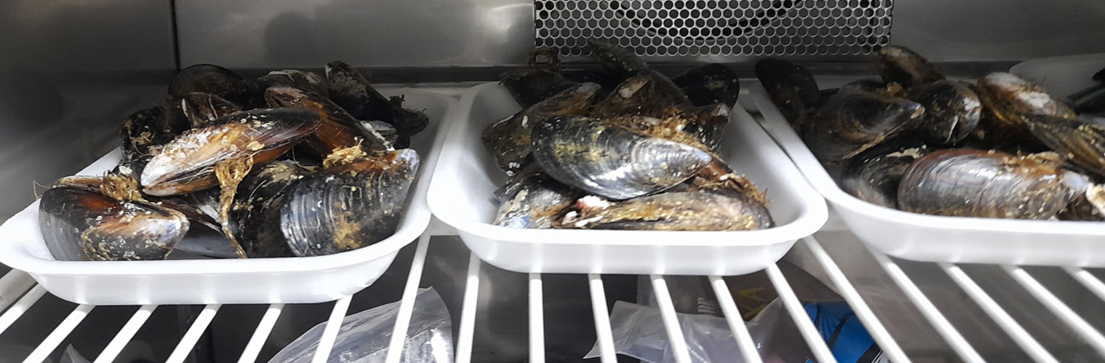
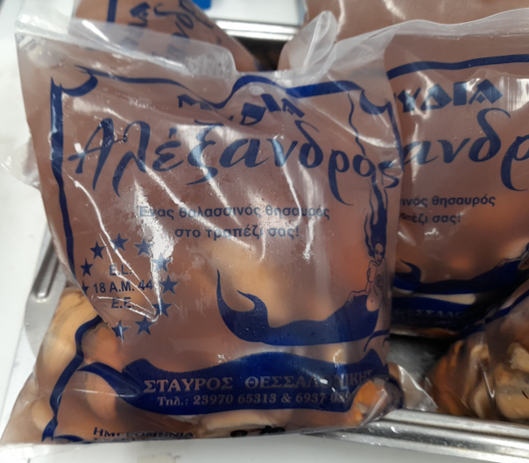
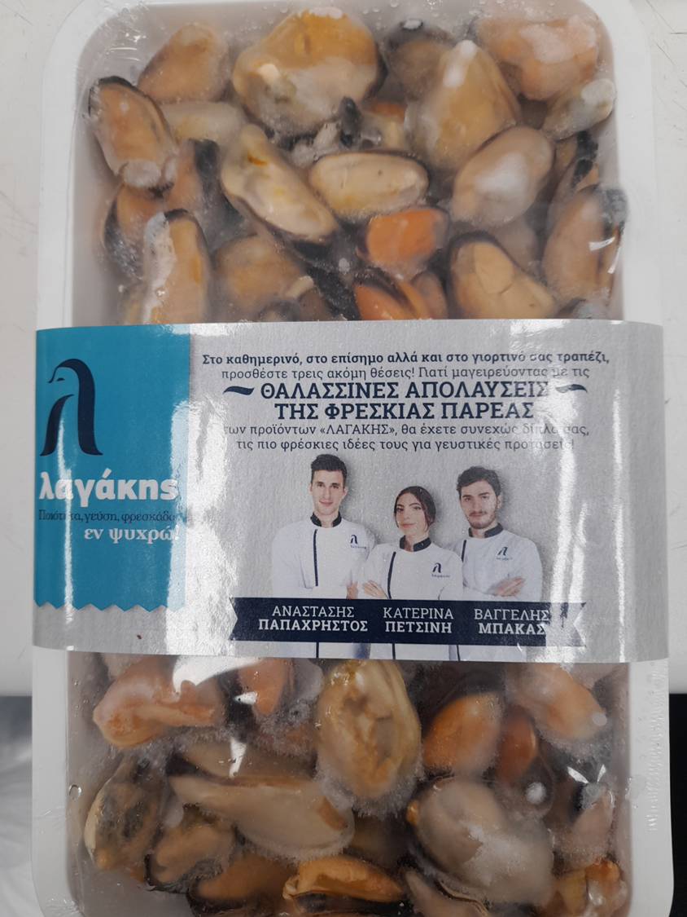
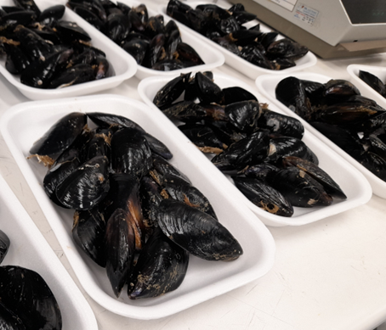
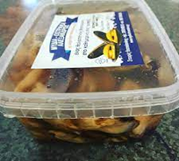
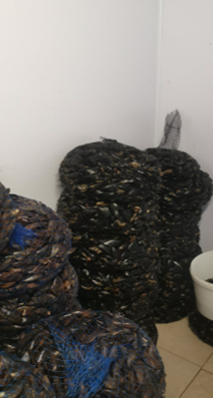
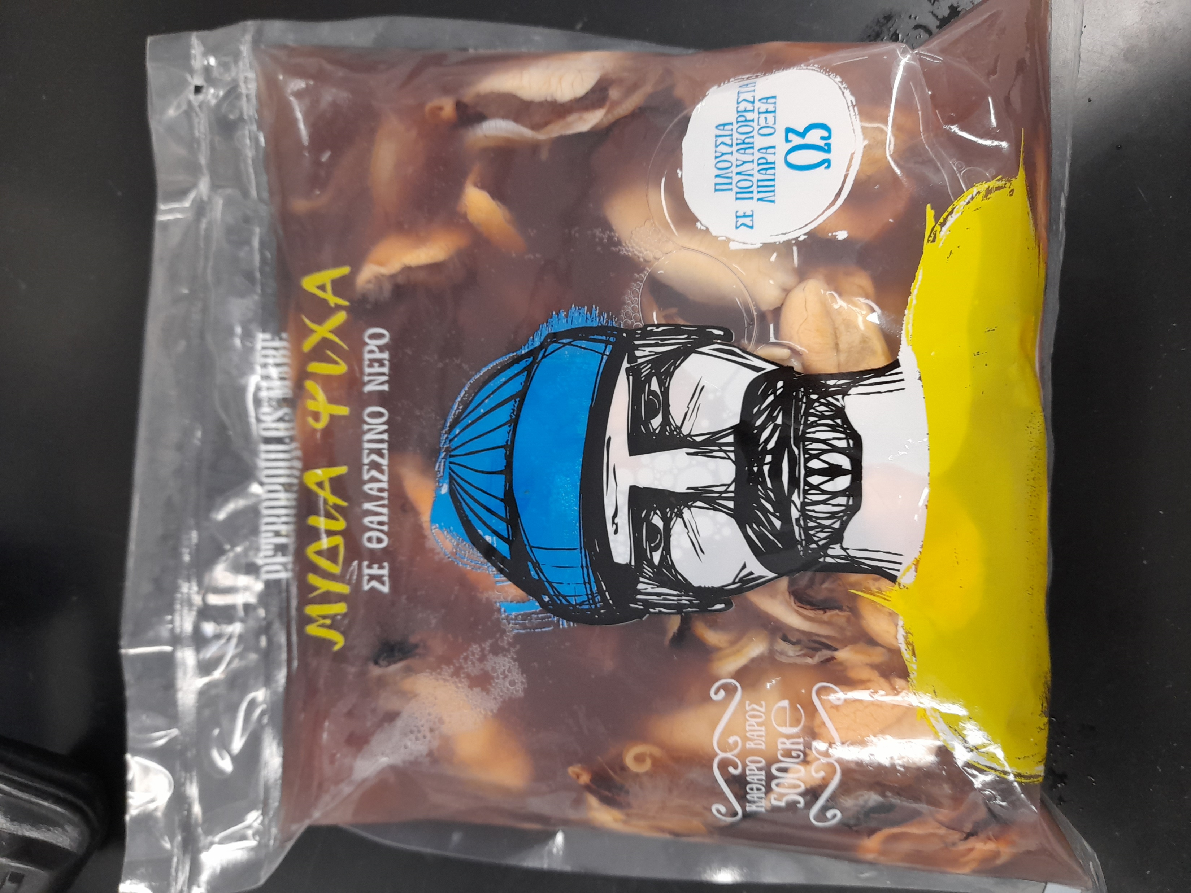
MATERIALS AND METHODS
Samples collection
3 batches - fresh mussels without the shell in bags with seawater – Mytilus galloprovincialis
Greek producer 1 – Thermaikos gulf
Greek producer 2- Strymonikos gulf
2 batches of fresh mussels (alive) with the shell – Mytilus galloprovincialis
Greek producer 1 – Thermaikos gulf
Spanish producer
2 batches without the shell – Mytilus chilensis
Brand 1
Brand 2

Slide 2
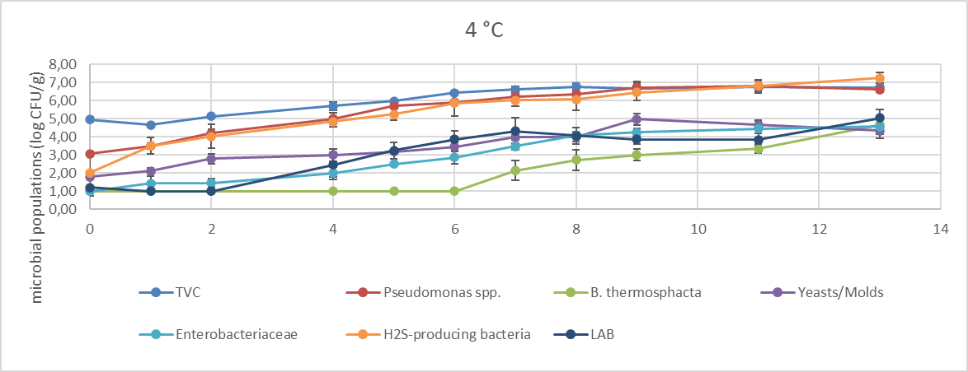
Conventional microbiological analysis –Batch 2
Pseudomonads and H₂S producing bacteria were the dominant microbial groups – producing mostly alkaline metabolites
After 4th day LAB and B. thermosphacta growth – production of lactic and acetic acid – pH value decreased

Slide 3
genus | MS2.2.D1 | MS2.2.D3 | MS2.2.D6 | MS2.4.D1 | MS2.4.D3 | MS2.4.D6
Photobacterium | 0,000 | 0,014 | 0,009 | 0,692 | 0,000 | 0,022
Ralstonia | 0,100 | 0,803 | 0,174 | 0,156 | 0,128 | 1,175
brochothrix | 0,008 | 0,335 | 0,700 | 0,187 | 0,415 | 1,044
pseudoalteromonas | 1,252 | 16,381 | 27,588 | 7,618 | 23,125 | 13,807
psychromonas | 0,108 | 0,895 | 1,093 | 0,367 | 0,868 | 0,656
enterobacter | 0,122 | 0,003 | 0,000 | 0,121 | 0,000 | 0,000
corynebacterium | 7,912 | 5,635 | 5,428 | 7,933 | 5,248 | 4,766
lactobacillus | 0,346 | 0,032 | 0,002 | 0,299 | 0,348 | 0,129
propionibacterium | 3,836 | 2,480 | 1,692 | 2,629 | 2,423 | 1,888
anaerococcus | 0,607 | 0,187 | 0,264 | 1,382 | 0,562 | 0,729
campylobacter | 0,387 | 0,308 | 0,223 | 0,204 | 0,128 | 0,452
marinifilum | 1,309 | 0,111 | 0,002 | 0,085 | 0,000 | 0,004
aeromonas | 1,128 | 0,046 | 0,009 | 0,069 | 0,107 | 0,184
acinetobacter | 7,857 | 4,381 | 2,492 | 5,056 | 5,229 | 3,089
pseudomonas | 0,886 | 0,427 | 0,809 | 0,311 | 0,898 | 0,887
shewanella | 0,283 | 0,736 | 1,066 | 0,562 | 1,351 | 0,934
synechococcus | 1,470 | 1,422 | 0,546 | 0,491 | 0,209 | 0,405
leuconostoc | 15,999 | 2,934 | 1,496 | 11,415 | 0,896 | 7,345
psychrilyobacter | 0,383 | 1,247 | 0,711 | 0,754 | 0,021 | 0,825
streptococcus | 4,660 | 7,233 | 3,589 | 6,750 | 5,957 | 3,957
bacillus | 0,051 | 0,049 | 0,000 | 0,275 | 0,000 | 0,096
vibrio | 0,171 | 0,311 | 0,192 | 0,358 | 0,540 | 0,118
lactococcus | 0,338 | 0,241 | 0,824 | 0,500 | 0,661 | 3,110
staphylococcus | 3,406 | 3,445 | 2,970 | 4,591 | 3,959 | 2,131
microbacterium | 0,179 | 0,000 | 0,013 | 0,014 | 0,081 | 0,012
mycoplasma | 1,492 | 0,105 | 0,004 | 0,097 | 0,005 | 0,163
fusobacterium | 0,849 | 1,174 | 1,324 | 1,657 | 0,623 | 0,942
tenacibaculum | 0,037 | 0,051 | 0,004 | 0,197 | 0,100 | 0,002
enhydrobacter | 2,339 | 1,863 | 0,947 | 1,778 | 2,956 | 1,432
arcobacter | 0,035 | 0,038 | 0,060 | 0,009 | 0,007 | 0,004
flavobacterium | 0,617 | 0,111 | 0,117 | 0,156 | 0,033 | 0,071
rubritalea | 0,004 | 0,003 | 0,136 | 0,005 | 0,043 | 0,002
marinobacterium | 0,004 | 0,054 | 0,005 | 0,012 | 0,009 | 0,006
hydrotalea | 0,086 | 0,752 | 0,005 | 0,137 | 0,095 | 0,742
clostridium | 0,000 | 0,000 | 0,018 | 0,000 | 0,000 | 0,024
moritella | 0,002 | 0,003 | 0,007 | 0,012 | 0,007 | 0,006
psychrobacter | 3,103 | 19,194 | 30,745 | 15,852 | 23,341 | 31,096
16S metabarcoding – Most abundant microorganisms
BATCH 2
Green → measured also in Petri dishes
Blue → potentially pathogenic
Orange → most abundant groups

Slide 4
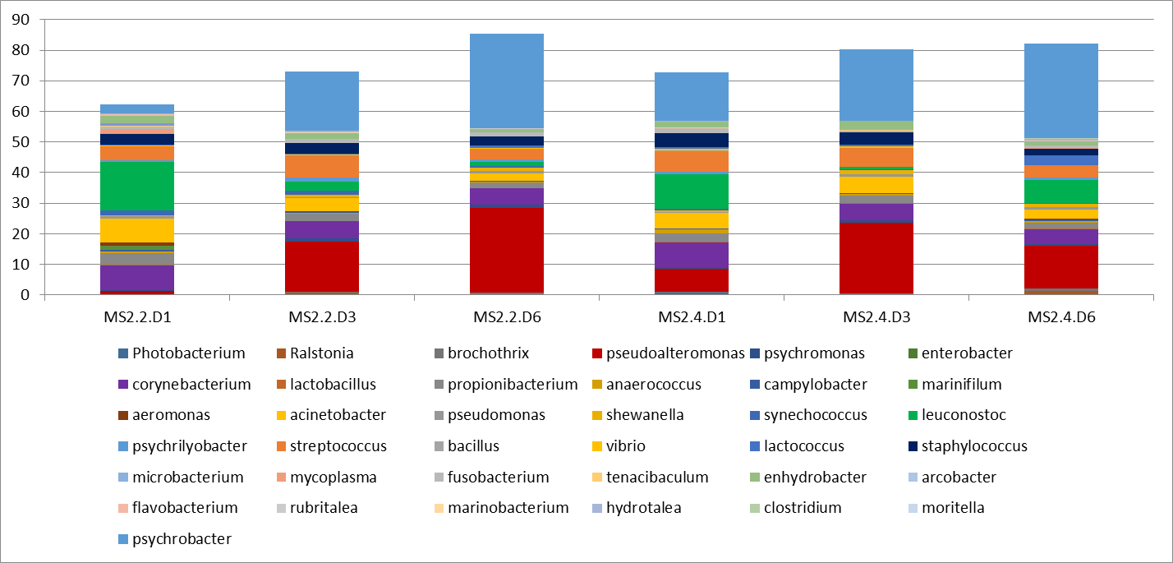
16S metabarcoding – Batch 2

Slide 5
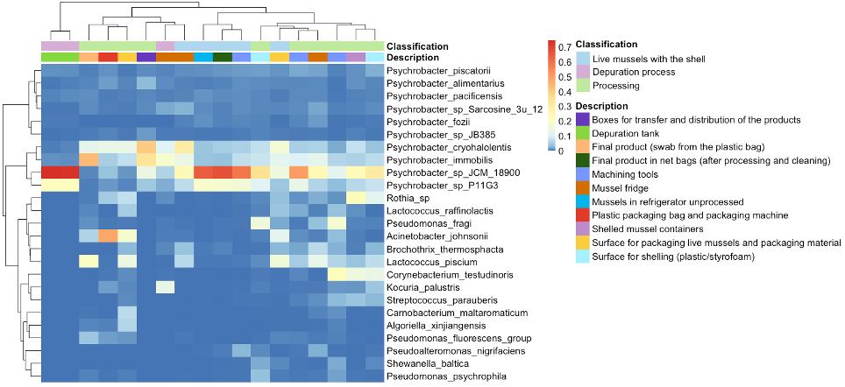
Mussels processing plant – Batch 2 or 5 - UNINA

Slide 6
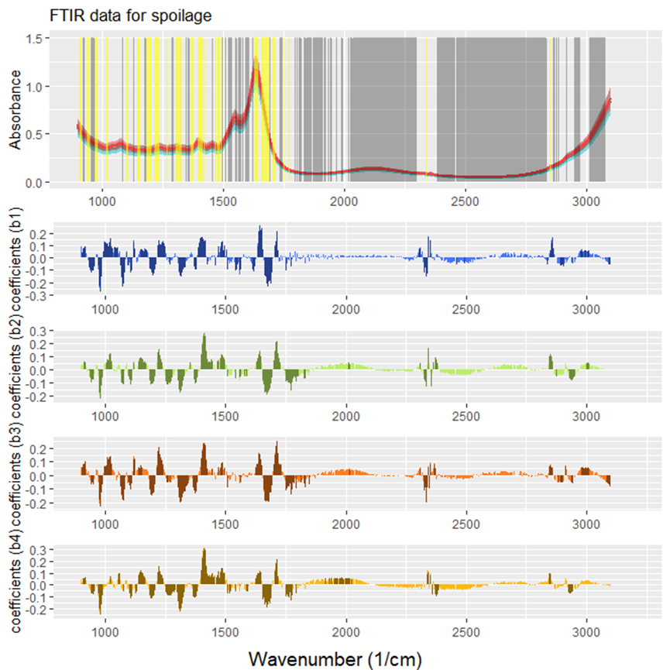
Indicative FTIR analysis – chicken meat
The regions between 1630-1680, 1380-1400, 1480, 1320, 1230, 1200, 970 cm-1 contain key features which are either positively or negatively correlated to the spoilage evolution
Protein content (amines, amides, amino acids) → amide I at 1640 cm−1, amide II at 1550 cm−1, as well as 1240 and 1088 cm−1 bands which are described as stretching ν(C–N) vibrations probably originating from free amino acids are expected to be among the most significant features
Bands around 1320 and 1655 cm-1, probably corresponded to Amide III and moisture content (OH stretching) with the contribution of Amide I could be relevant with protein decrease during spoilage. The increasing time-dependent trend of the spectral intensity observed for the band at 1675 cm−1 arises from the growing number of free acidic amino acids
Lipids can be hydrolyzed by microorganisms such as Pseudomonas spp., Micrococcus sp., in cold temperature. A band at 1745 cm⁻¹ is assigned to the carbonyl stretching vibration of triglycerides, while a second one at 1715 cm⁻¹ could be assigned to free fatty acids that were originated by the possible degradation of their lipid contents
Bands 967 to 1200 cm⁻¹ are mainly related to carbohydrates while peaks of weak bands close to 920 cm⁻¹ can be assigned to C-H bending vibrations which can be found in monosaccharides, such as glucose and fructose

Slide 7
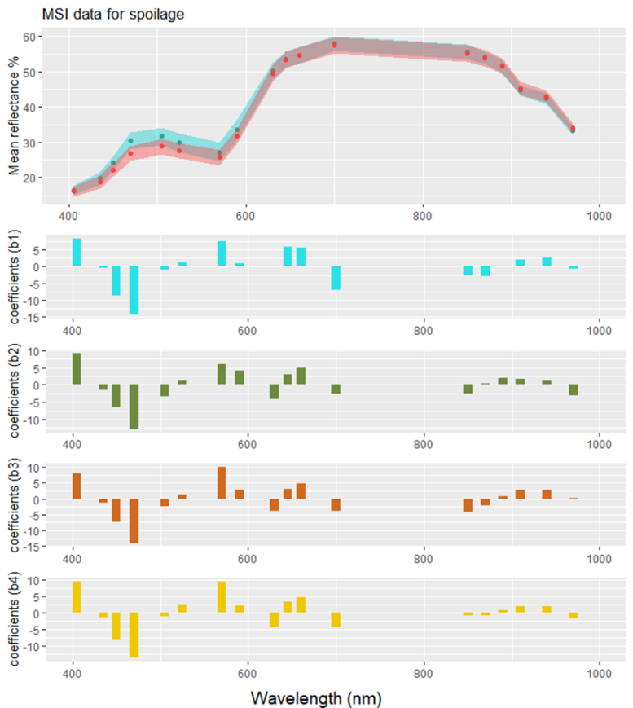
Indicative MSI analysis chicken meat
Bands related to wavelengths 405, 450, 470, 570, 645, 660, 700 nm were among the most important ones for the prediction of microbial quality. The key bands that could be associated with microbial spoilage are those arise from myoglobin and derivatives. Wavelengths at 450, 470 and 570 nm are attributed to deoxymyoglobin, metmyoglobin and oxymyoglobin, respectively
A band at 645 nm, which can be attributed to sulfmyoglobin. Sulfmyoglobin is the product of the interaction of myoglobin with H₂S in the presence of oxygen (O2) (role of H₂S producing bacteria??)

